Slide 1

Future
Future

Slide 2

Future can be divided into 4 forms
Future Plans (I’m going to work for a Swedish company next month)
Speculation about the future (If I work hard I’ll get a better job)
Predictions about the future (I’ll earn more money)
A scheduled event (The plane leaves at 9pm)

Slide 3


Will
I’ll give you my phone number.
To express a future decision or intention at the moment of speaking:
I’ll do the washing-up.
To express an offer:

Slide 4
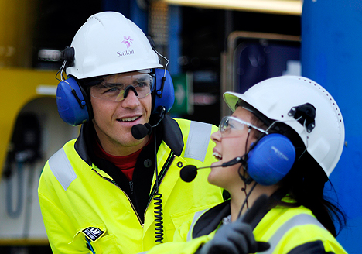
Going to (is/am + going to + infinitive)
1. To express a future decision, intention or plan made before the moment of speaking
Are you going to be working at Mongstad long?
Yes, I’m going to be here until September.

Slide 5


Going to (is/am + going to + infinitive)
2. When we can see or feel something that is about to happen.
It’s going to rain.
Watch out! It’s going to fall.

Slide 6

“Ing” form
Can be used for plans or arrangements, particularly with the verbs “come” and “go”.
(I’m coming over on Friday/I’m going home early tonight)

Slide 7
Scheduled future events (using the present tense)
My flight leaves at 12:15
The ship sails this afternoon
The meeting starts at noon
Negotiations begin in June
NB!
It is not incorrect to say «My flight is leaving at 12:15» though this might imply a sense of urgency: «Hurry up, my flight is leaving at 12:15!».
It is not incorrect to use «My flight will leave at 12:15» though a native speaker wouldn’t use this form in a neutral conversation.

Slide 8
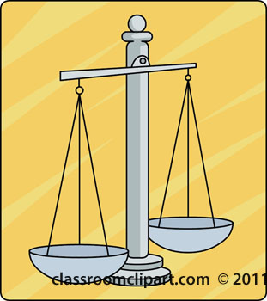
IF we want to speculate ……
BALANCE is the key.
If I win the lottery I will buy a car
If I won the lottery I would buy a car
If I had won the lottery I would have bought a car

Slide 9
Future – links to exercises
http://www.englisch-hilfen.de/en/grammar/future_perfect.htm
http://www.englisch-hilfen.de/en/grammar/future_pro.htm
http://www.englisch-hilfen.de/en/grammar/future_perfect_continuous.htm
http://www.englisch-hilfen.de/en/grammar/future_diagram.htm

